Slide 1

Time Efficiency of Non-Recursive Algorithms
Decide on parameter n indicating input size
Identify algorithm’s basic operation
Determine worst, average, and best cases for input of size n
Set up a sum for the number of times the basic operation is executed
Simplify the sum using standard formulas and rules and determine the efficiency class.

Slide 2


Useful Summation Formulas and Rules
$\sum_{i=l}^{u}{1}$ = 1+1+…+1 = $u − l$+ 1 (add 1s $u − l$+ 1 times)
In particular, $\sum_{i=1}^{n}{1}$= n - 1 + 1 = n ∈ Θ(n)
$\sum_{i=1}^{n}{i}$= 1+2+…+n = n(n+1)/2 ≈ n²/2 ∈ Θ(n²)
$\sum_{i=1}^{n}{i^{2}}$= 1²+2²+…+n² = n(n+1)(2n+1)/6 ≈ n³/3 ∈ Θ(n³)
$\sum_{i=0}^{n}{a^{i}}$= 1 + a +…+ a^{n} = (a^{n+1} - 1)/(a - 1) for any a ≠ 1
In particular, $\sum_{i=0}^{n}{2^{i}}$= 2⁰ + 2¹ +…+ 2^{n} = 2^{n+1} - 1 ∈ Θ(2^{n} )
Upper
limit
Expression to
be added
$\sum_{i=l}^{u}{1}$
lower
limit
index

Slide 3

Useful Summation Formulas and Rules
$\sum{（a_{i}±b_{i})}$ = $\sum{a_{i}}$ ± $\sum{b_{i}}$
$\sum{{cb}_{i}}$ = $c\sum{b_{i}}$
$\sum_{i=l}^{u}{a_{i}}$= $\sum_{i=l}^{m}{a_{i}}$+ $\sum_{i= m+1}^{u}{a_{i}}$
$\sum_{i=l}^{u}{(a_{i}−a_{i−1})}$= $a_{u}−a_{l−1}$

Slide 4
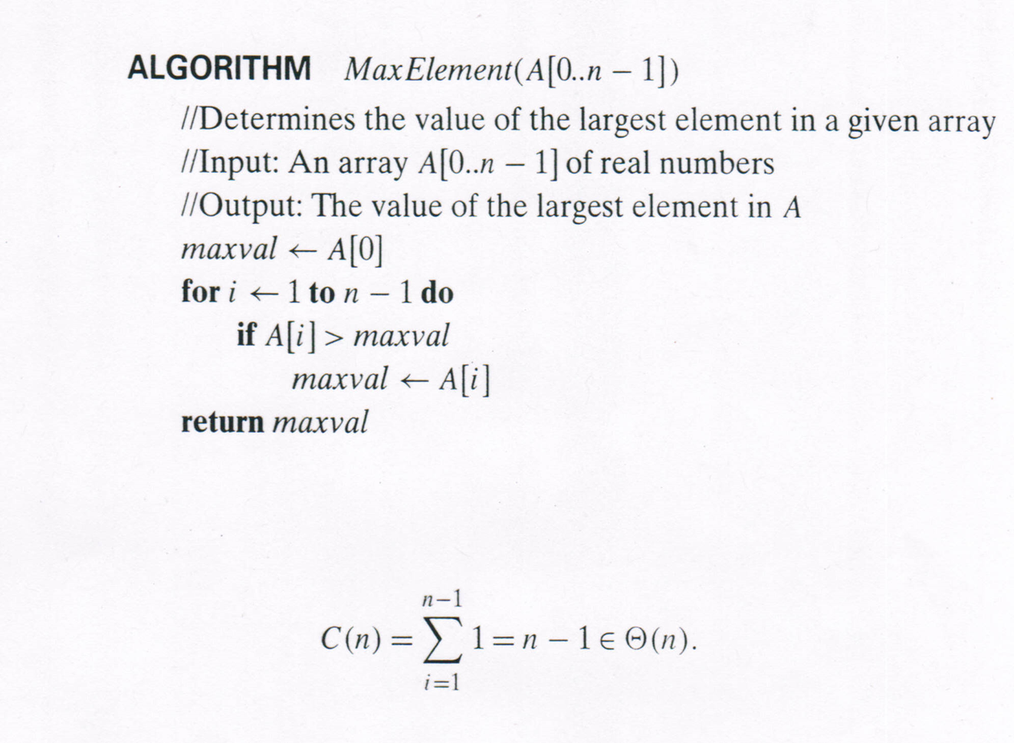
Example: Maximum Element Problem

Slide 5
Example: Maximum Element Problem
Input size: n
Basic operation:
comparison
No worst, average, and best cases.

Slide 6

Example: Maximum Element Problem
Setting up a sum:
$$\sum_{i=1}^{n−1}{1}$$
Simplify the sum:
Use summation formula
$\sum_{i=l}^{u}{1}$ = $u − l$+ 1 (1)
to simplify the sum
$\sum_{i=1}^{n−1}{1}$ = n$−1−1$+ 1
= n$−1 ∈$ Θ(n)
1 comparison
In each iteration

Slide 7
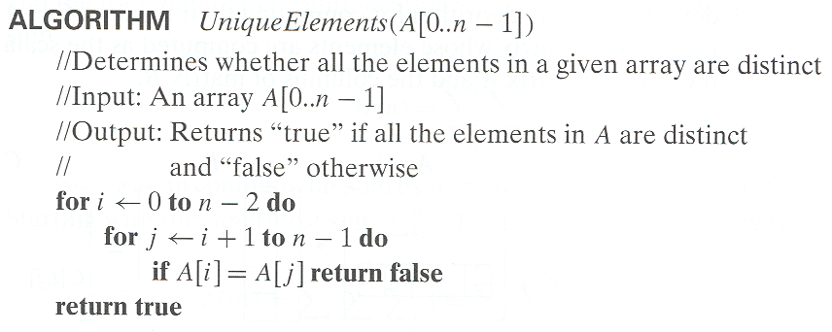
Example: Element Uniqueness Problem

Slide 8
Example: Element Uniqueness Problem
Input size: n
Basic operation:
comparison

Slide 9

Example: Element Uniqueness Problem
Worst, average, and best cases for input of size n
$C_{best}\left(n\right)=1$

Slide 10

Example: Element Uniqueness Problem
Set up a sum for the worst case:
$\sum_{i=0}^{n−2}{\sum_{j=i+1}^{n−1}{1}}$
outer sum
Inner sum

Slide 11
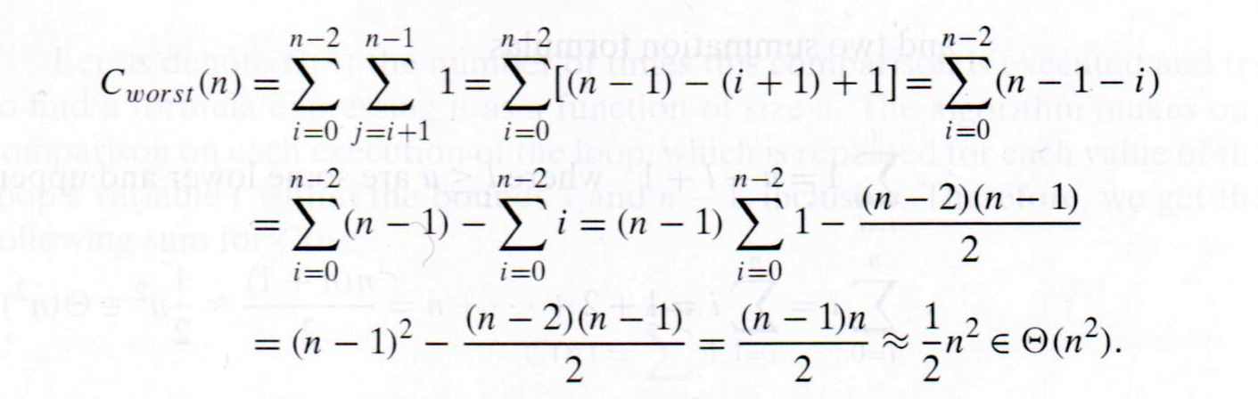

Example: Element Uniqueness Problem
Simplify the sum:
Use summation formulas and rules:
$\sum_{i=l}^{u}{1}$ = $u − l$+ 1 (1)
$\sum{（a_{i}±b_{i})}$ = $\sum{a_{i}}$ ± $\sum{b_{i}}$ (2)
$\sum{{cb}_{i}}$ = $c\sum{b_{i}}$ (3)
$\sum_{i=1}^{n}{i}$ = n(n+1)/2 (4)
1
2
3
4
5
6

Slide 12
Example: Element Uniqueness Problem
Simplify the sum:
Use summation formulas and rules:
$\sum_{i=l}^{u}{1}$ = $u − l$+ 1 (1)
$\sum{（a_{i}±b_{i})}$ = $\sum{a_{i}}$ ± $\sum{b_{i}}$ (2)
$\sum{{cb}_{i}}$ = $c\sum{b_{i}}$ (3)
$\sum_{i=1}^{n}{i}$ = n(n+1)/2 (4)
1
2
3
4
5
6

Slide 13
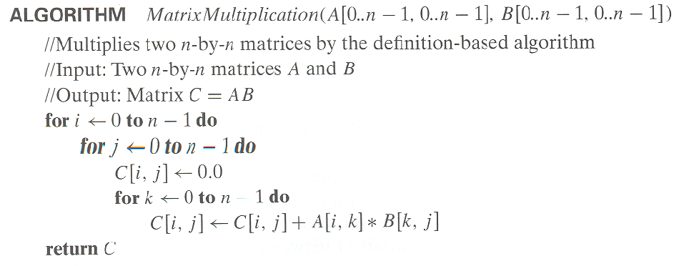
In-Class Exercise: Matrix Multiplication
Analyze the algorithm of matrix multiplication. Determine its efficiency class.
Hints:
Follow the five steps.
The basic operation is the most expensive operation in the inner most loop
The sum is a triple sum.
Simplify the sum from the rightmost (inner most).
Determine the efficiency class from the function simplified.

Slide 14
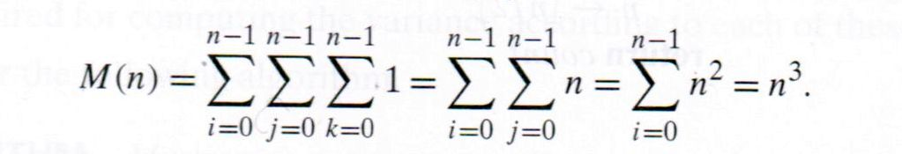

Solution to In-class Exercise: Matrix Multiplication
Input size: n
Basic operation: multiplication.
No worst, average, best cases.
In the triple sum, the rightmost sum is for the inner most loop. It is the innermost sum. Its upper and lower limits are from the innermost loop.
The middle sum is for the middle loop, the left sum is for the outer.
The triple sum should be simplified from the innermost (rightmost).
The sum is simplified into $n^{3}$.
The efficiency class is Θ($n^{3}$)

Slide 15
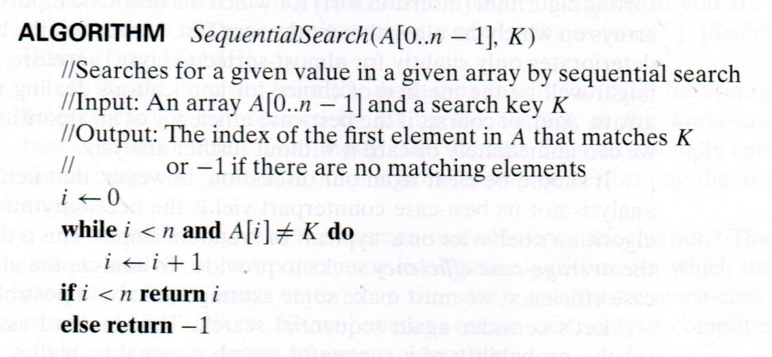

Example: Sequential search
To make analysis easier, convert the while loop into a for loop:
for i $←$ 0 to n -1 if A[i] = K return i return -1
Input size: n
Basic operation: comparison.
Worst, average, and best cases for input of size n
$C_{best}\left(n\right)=1$
$C_{worst}\left(n\right)= \sum_{i=0}^{n−1}{1}$ = n
The efficiency class of the best case is Θ($1$). The efficiency class of the worst case is Θ($\text{n}$)

Slide 16
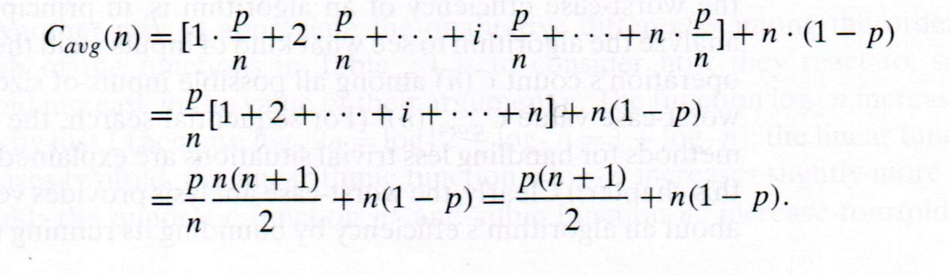

Example: Sequential search
Average case:
Assume the probability to find K in A is P.
The number of comparisons can be considered as a random variable.
The average number of comparison is the expectation of the random variable:
$C_{avg}\left(n\right)= \sum_{i=0}^{n−1}{(}$ $P_{i} ∙(i+1))$ + n $∙$ (1- P) (1)
where $P_{i}$ is the probability that A[i] is equal to K. ($P_{1}$+ $P_{2}$+…+ $P_{n}$= $P$)
When the probability is equal for all the array elements to be equal to K, the average number is calculated as
$C_{avg}\left(n\right)= \sum_{i=0}^{n−1}{(}$ $\frac{P}{n}∙(i+1))$ + n $∙$ (1- P) (2)

Slide 17

Example: Sequential search
Average case:
Assume the probability to find K in A is P.
The number of comparisons can be considered as a random variable.
The average number of comparison is the expectation of the random variable:
$C_{avg}\left(n\right)= \sum_{i=0}^{n−1}{(}$ $P_{i} ∙(i+1))$ + n $∙$ (1- P) (1)
where $P_{i}$ is the probability that A[i] is equal to K. ($P_{1}$+ $P_{2}$+…+ $P_{n}$= $P$)
When the probability is equal for all the array elements to be equal to K, the average number is calculated as
$C_{avg}\left(n\right)= \sum_{i=0}^{n−1}{(}$ $\frac{P}{n}∙(i+1))$ + n $∙$ (1- P) (2)

Slide 18
Recommended Reading
2.3

